Slide 1


NEXT GEN EMPLOYABILITY PROGRAM
CREATING A FUTURE-READY WORKFORCE
Student Name :
Dipak Waghmode
Student ID :
STU637346a22ba581668499106
Mobile No :
7499752883
Mail ID :
dipakdw2003@gmail.com
College Name :
AISSMS IOIT, Pune

Slide 2
CAPSTONE PROJECT SHOWCASE
Project Title
Power BI Driven Exhaustive Analysis of Indian Agriculture Sector (DA)
Abstract | Problem Statement | Project Overview | Proposed Solution | Technology Used | Modelling & Results | Conclusion | Q&A

Slide 3
Abstract :
1
The abstract outlines the methodology and objectives of employing Power BI in conducting a thorough analysis of the Indian agriculture sector, aiming to unveil intricate patterns and trends.
2
Leveraging the capabilities of Power BI, the project endeavors to provide stakeholders with a holistic understanding of agricultural dynamics, spanning crop yields, market fluctuations, and governmental policies.
3
Through the amalgamation of diverse datasets and robust analytics, the project aspires to offer actionable insights that can inform farmers for better decision-making.
4
By harnessing the power of data visualization and analytics, the project seeks to drive transformative changes in the Indian agriculture sector, fostering sustainability, efficiency, and resilience.

Slide 4


Problem Statement :
Optimizing MSP Allocation:
Explore the current allocation of MSP across different crops. Identify whether there are disparities in MSP allocation based on factors such as geographical region, crop type, or economic significance. The problem could focus on optimizing the allocation to ensure fair pricing and support for farmers across all regions and crops.

Slide 5

Project Overview :
Analyzing Minimum Support Price (MSP) of Crops and Insights
This Power BI project focuses on analyzing Minimum Support Price (MSP) data of crops to provide actionable insights for policymakers, stakeholders, and farmers. Through data collection, exploratory analysis, and predictive modeling, the project aims to understand MSP dynamics, identify trends, and forecast future prices. Interactive dashboards will be created to present findings effectively, aiding evidence-based decision-making and addressing agricultural pricing and food security challenges.

Slide 6
Proposed Solution :
Calculate the Average of Past 3 Years' Production:
Gather production data for the selected crop for the past three years.
Add up the production figures for each year and divide by 3 to find the average production over the past three years.
Calculate the Production of the Current Year:
Obtain data on the production of the crop for the current year.
Compare Current Year Production with the Average:
Compare the production of the current year with the average production calculated in step 1.
If the current year's production is greater than the average of the past three years, then the crop will not qualify for the Minimum Support Price and vice versa.

Slide 7
Technology used
Web Scraping (Python):
Utilize Python libraries such as Beautiful Soup or Scrapy to extract crop production data from relevant websites or online databases.
Write scripts to scrape data on crop production for the past three years and current year from trusted sources.
Python:
Use Python for data manipulation, analysis, and comparison of production figures.
Calculate the average production for the past three years and compare it with the production of the current year to determine MSP eligibility.
Power BI:
Import the processed data into Power BI for visualization and reporting.
Create interactive dashboards and visualizations to present the analysis results.
Generate reports highlighting whether each crop qualifies for Minimum Support Price based on production comparisons.

Slide 8
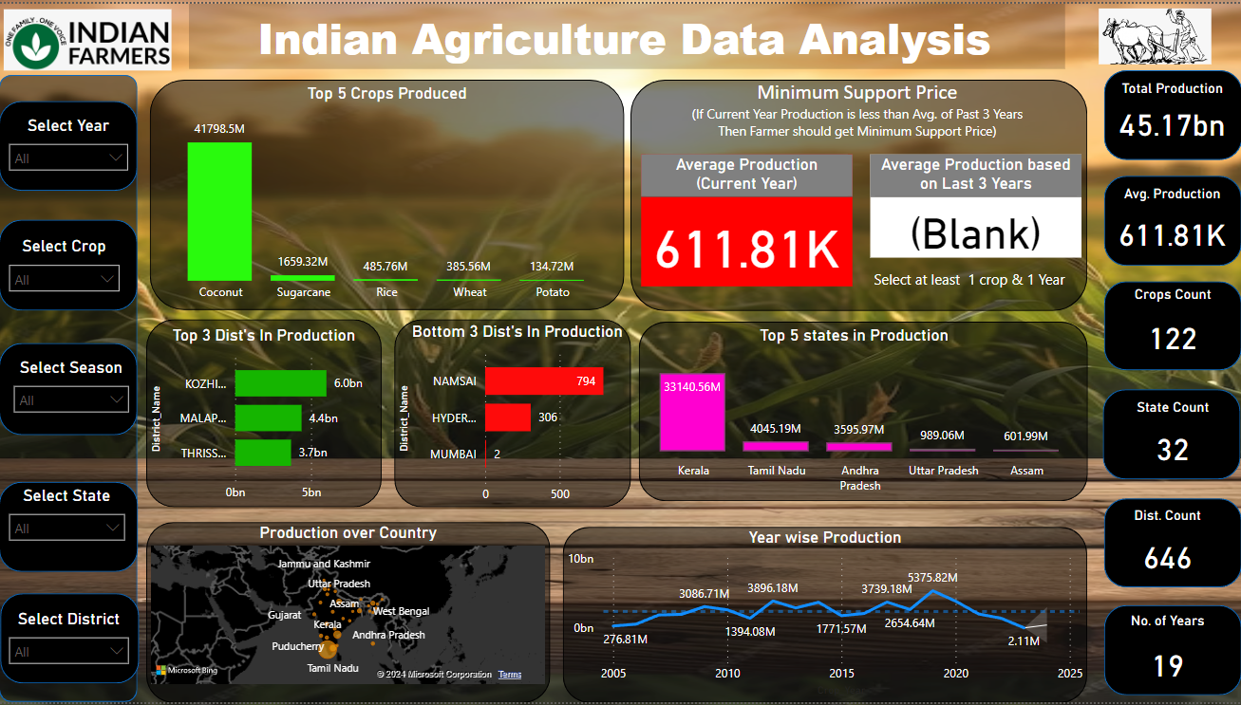
Modelling & Result :

Slide 9
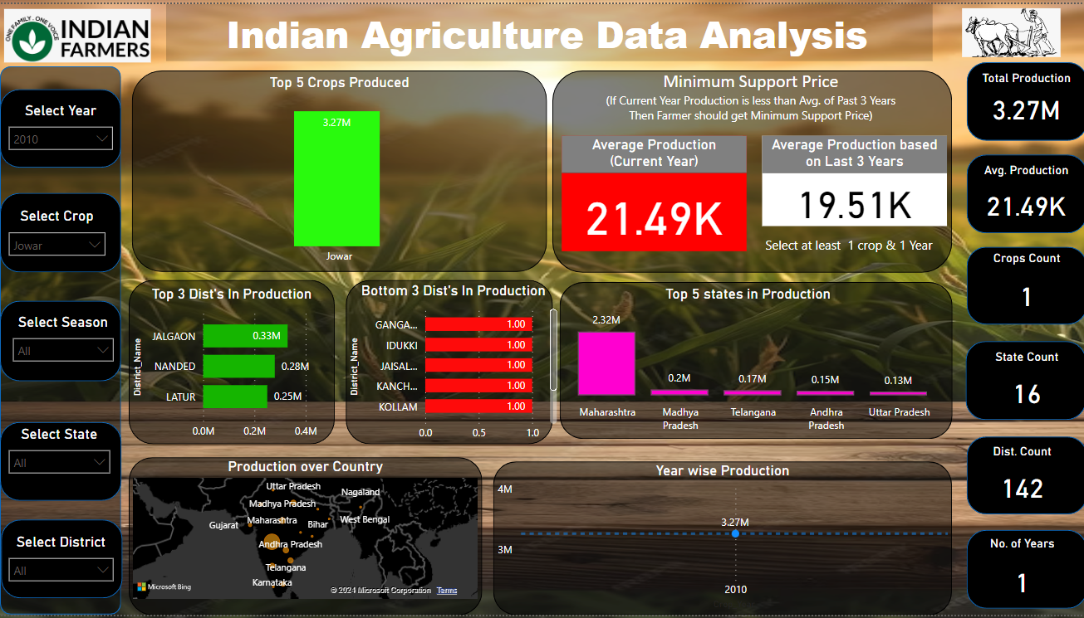
Modelling & Result
Checking MSP for
Year : 2010 Crop : Jowar

Slide 10

Conclusion :
In conclusion, the utilization of web scraping in Python coupled with Power BI has proven instrumental in analyzing crop production data for determining Minimum Support Price (MSP) eligibility. By scraping relevant websites and databases, we efficiently gathered historical production data and compared it with current-year figures to ascertain MSP qualification. Python's versatility facilitated data manipulation and comparison tasks seamlessly, ensuring accurate results. Additionally, Power BI's robust visualization capabilities enabled the creation of interactive dashboards and reports, offering stakeholders a clear understanding of crop MSP eligibility status. This streamlined approach not only enhances decision-making processes but also underscores the significance of leveraging technology to address agricultural challenges. Moving forward, the integration of these technologies presents promising opportunities for further advancements in agricultural policy formulation and implementation.

Slide 11


Notes:
Thank You !!

